Slide 1

WELCOME
Shrewd Investor
Course
Introduction
to
Stock Markets

Slide 2
Fundamental Analysis
Ratio Analysis
Screener.in

Slide 3
1. Market Capitalization
Or MarCap
Current valuation of company
No of shares * CMP
MarCap in Crore | Classification
< 5000 | Small Cap
5000 – 20000 | Medium Cap
> 20000 | Large Cap

Slide 4
2. Price/Earning (PE)
Valuation = Cheap or Expensive
PE = Current Price
Earing Per Share
Stock PE v. Industry PE

Slide 5
3. Return on Capital Employed (ROCE)
Efficiency
ROCE = Earings Before Interest & Tax (EBIT)
Capital Employed

Slide 6
4. Debt/Equity (D/E)
How much loan or debt company has?
DE = Total Debt
Shareholder’s Equity

Slide 7
5. Interest Coverage Ratio
Can company pay interest on its loan?
EBIT
Interest Expense

Slide 8
6. Dividend Yield
Dividend % on stock price
Annual Dividend
Share Price

Slide 9
7. Sales YoY & QoQ

Slide 10

Financial Products
Stocks / Equity

Slide 11

Stock Market are also known as Stock Exchange.
Total 23 stock exchange
21 Regional Stock Exchange
2 National Stock Exchange

Slide 12
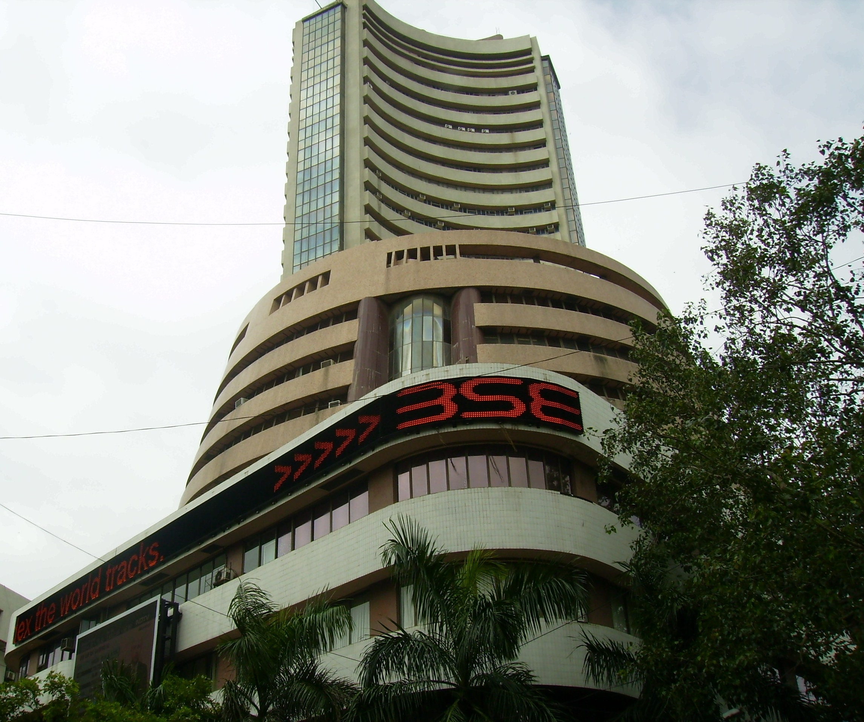

2 National Stock Exchange
Bombay Stock
Exchange (BSE)
National Stock
Exchange (NSE)
India and Asia’s first Stock Exchange
1875
Biggest Stock Exchange of India
1992

Slide 13

How to make
MONEY?
Study!!!

Slide 14

Technical
Analysis
Fundamental
Analysis

Slide 15
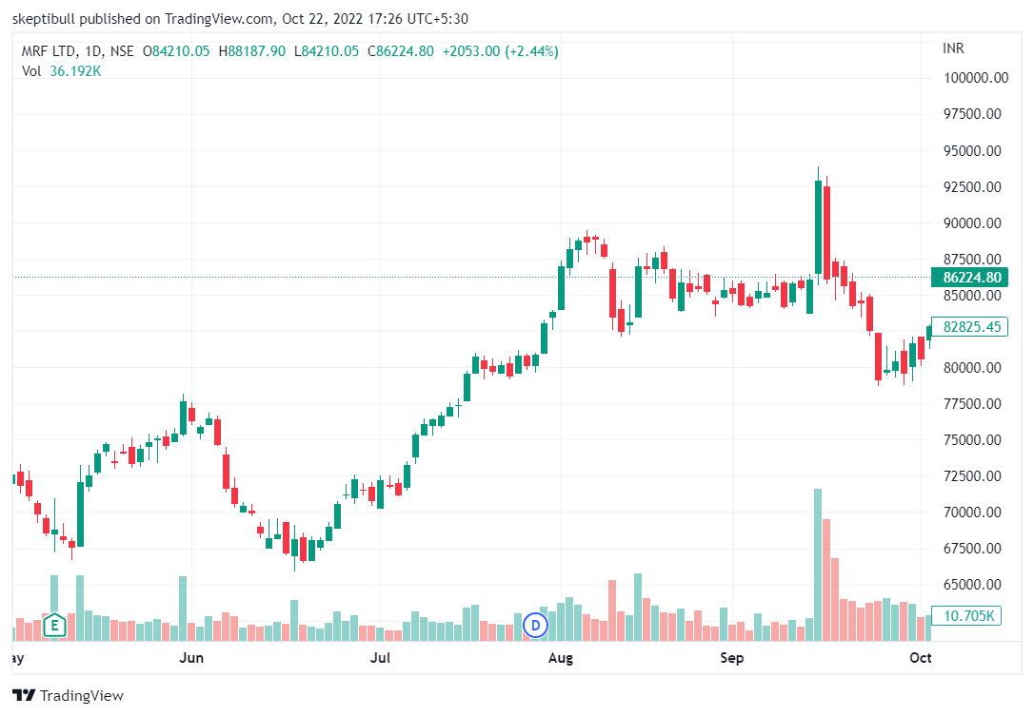
Technical
Analysis
Chart
Analysis
=
Candlesticks
Price Patterns
Moving Average
Price
Volume

Slide 16
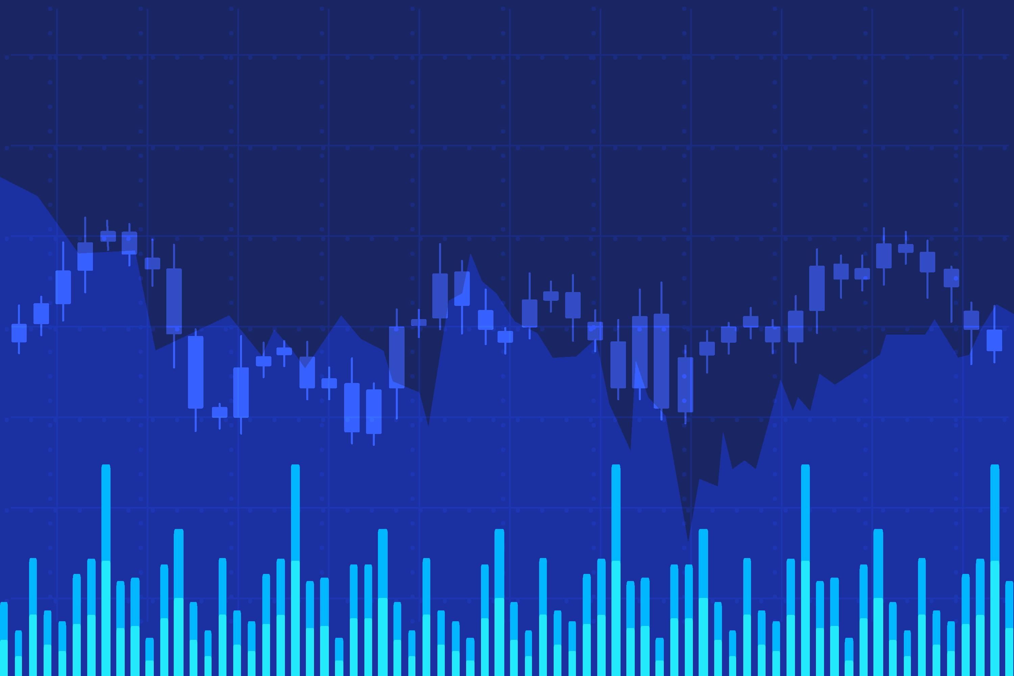
Technical Analysis
Trade
Equity
Futures
Options
Commodity
Forex
Crypto

Slide 17
Why Trade?
Quick Money
Make money in any Trend!

Slide 18

Do Traders make Money?

Slide 19

NO!!!
95% of retail traders are in Loss!!!

Slide 20

Institutions
Retail Trader
Big Players
Professionals
Experts

Slide 21
Retail Trader
FUEL
Is trading free?
Broker
NSE/BSE
GOVT
Marker Guru
Professionals

Slide 22

Will Retail Players never make
Money?

Slide 23



YES!
Investing
&
Compounding

Slide 24
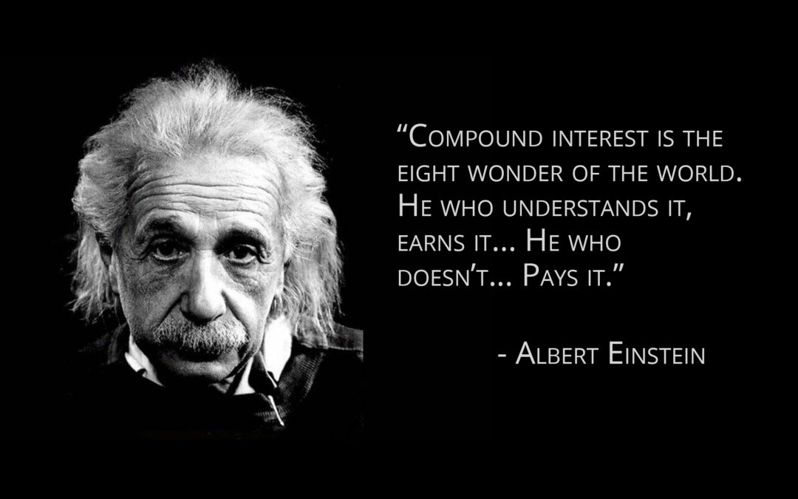

Slide 25

100
10%
= 110
110
10%
= 121
121
10%
= 133
Power of Compounding

Slide 26

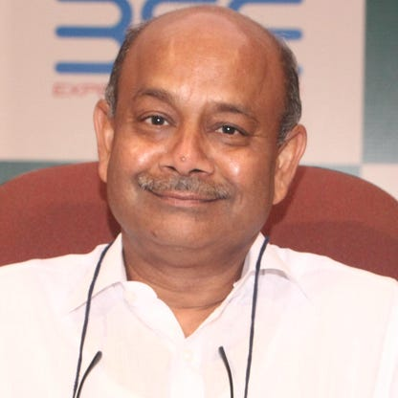
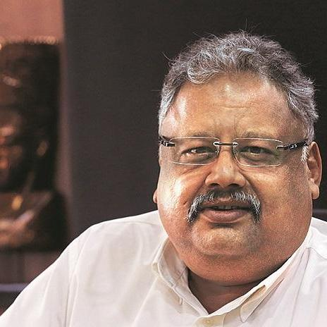
Warren Buffett
Radhakishan
Damani
Rakesh
Jhunjhunwala

Slide 27

Purpose of entering Stock Market?
Wealth Creation
Financial
Goals
Car
House
Foreign Tour
Child Education
Savings

Slide 28

Investment
Fundamental Analysis
Quality of Stock
Future
Management
Books
Financial Ratios

Slide 29
How to select stocks?
Which stock to buy?
Which stock to avoid?
Which stocks will rally?
When to enter?
When to exit?
Capital Management?
Risk Management?

Slide 30

Shrewd Investor
Fundamental Analysis
Ratio Analysis
Stock Selection
Investment Strategies
Risk Management
Swing Trading
Sunday 10 AM
Duration 6-8 hours
Zoom or Skype

Slide 31


Shrewd Investor
Rs 10,000/-
Rs 999/-

Slide 32
#06283D
#F4F4F2
#FEB202
#FF8701
Buyers
Sellers

